Slide 1

DISCLAIMER
The information in this presentation is provided to you by PT. AXAR Technology Raya, solely for informational purposes and does not constitute an offer to buy, sell or issue, or a solicitation of an offer to sell, buy or acquire any securities of the Company in any jurisdiction or an inducement to enter into investment activity, nor may it or any part of it form the basis of or be relied on in connection with any contract or commitment whatsoever. No representations or warranties, express or implied, are made by the Company, any underwriters, any of their respective affiliates, directors, officers, employees, advisors or representatives with respect to, and no reliance should be placed, on the accuracy, fairness or completeness of the information presented or contained in this presentation. By viewing this presentation, you agree that none of the Company, any underwriters, nor any of their respective affiliates, directors, officers, employees, advisors or representatives accepts any responsibility or liability whatsoever for any loss howsoever arising from any information presented or contained in or derived from or omitted from this presentation. The information presented or contained in this presentation was obtained from various sources, including certain third parties, and has not been independently verified, and its accuracy is not guaranteed.
This presentation does not contain all relevant information relating to the Company or its securities, particularly with respect to the risks and special considerations involved with an investment in the securities of the Company. These materials are not an offer of securities for sale. Any public offering will be made by means of a prospectus that may be obtained from the issuer and that will contain detailed information about the company and management, as well as financial statements. This presentation speaks as of its date and the information presented or contained in this presentation is subject to change without notice or update.
This presentation contains statements that constitute forward-looking statements. These statements include descriptions regarding the intent, belief or current expectations of the Company or its officers about the future. These statements can be recognized by the use of words such as “expects,” “plans,” “will,” “estimates,” “projects,” “intends,” or words of similar meaning. Such forward-looking statements are not guarantees of future performance and involve risks and uncertainties, and actual results may differ from those in the forward-looking statements as a result of various factors and assumptions, many of which are beyond the Company’s control. The Company or any of its affiliates, advisors, representatives or underwriters has no obligation and does not undertake to revise forward-looking statements to reflect future events or circumstances.
THE INFORMATION CONTAINED IN THIS DOCUMENT IS HIGHLY CONFIDENTIAL AND MAY NOT BE FORWARDED, PUBLISHED OR DISTRIBUTED, DIRECTLY OR INDIRECTLY, TO ANY OTHER PERSON (WHETHER WITHIN OR OUTSIDE YOUR ORGANIZATION/FIRM) FOR ANY PURPOSE AND MAY NOT BE REPRODUCED IN ANY MANNER WHATSOEVER. ANY FORWARDING, PUBLICATION, DISTRIBUTION OR REPRODUCTION OF THIS DOCUMENT IN WHOLE OR IN PART IS UNAUTHORIZED.
MOBILE
DEVELOPMENT
DAY 1

Slide 2
OBJECTIVES
Pengelolaan Aset
Penggunaan Aset
Ikon Aplikasi
Nama aplikasi
Notes:
Save Time....:
The Platform will house/aggregate thousands of DIRECT SUPPLIERS. Buyer members are now abled to easily Pick whats best suitable for them.
Discover...:
Suppliers need to be a registered and verified members. There will be features such as ratings and certifications to boost further.
Grow Business:
Members akan di-empowered dengan sebuah tool digital yang yang tadinya menyerang industri, malah justru membuat mereka bisa menjadi lebih kompetitif di era digital.

Slide 3
Pengeloaan Aset
Aplikasi Flutter dapat menyertakan kode dan aset (resource). Aset adalah file yang dibundel dan diterapkan dengan aplikasi Anda, dan dapat diakses pada waktu proses. Jenis aset yang umum termasuk data statis (misalnya, file JSON), file konfigurasi, ikon, dan gambar (JPEG, WebP, GIF, animasi WebP / GIF, PNG, BMP, dan WBMP).
Notes:
Save Time....:
The Platform will house/aggregate thousands of DIRECT SUPPLIERS. Buyer members are now abled to easily Pick whats best suitable for them.
Discover...:
Suppliers need to be a registered and verified members. There will be features such as ratings and certifications to boost further.
Grow Business:
Members akan di-empowered dengan sebuah tool digital yang yang tadinya menyerang industri, malah justru membuat mereka bisa menjadi lebih kompetitif di era digital.

Slide 4
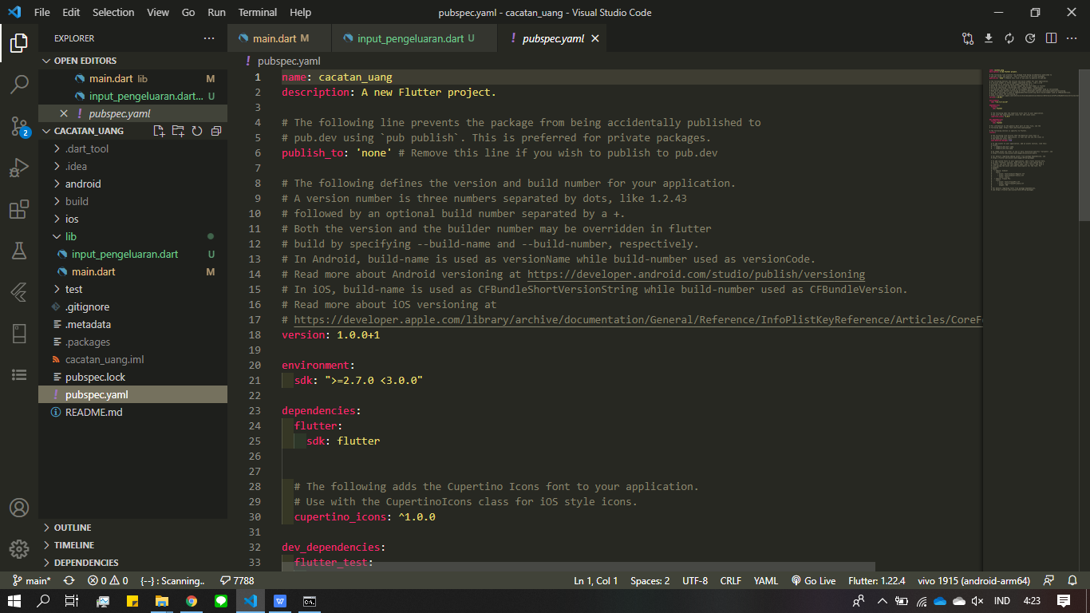
Pengeloaan Assets
Flutter menggunakan file pubspec.yaml, yang terletak di root project, untuk mengidentifikasi aset yang diperlukan oleh aplikasi.
Notes:
Save Time....:
The Platform will house/aggregate thousands of DIRECT SUPPLIERS. Buyer members are now abled to easily Pick whats best suitable for them.
Discover...:
Suppliers need to be a registered and verified members. There will be features such as ratings and certifications to boost further.
Grow Business:
Members akan di-empowered dengan sebuah tool digital yang yang tadinya menyerang industri, malah justru membuat mereka bisa menjadi lebih kompetitif di era digital.

Slide 5

Pengeloaan Asset
berikut ini adalah cara menambahkan asset pada flutter :
1. Silahkan buat directori baru di dalam project yang bernama “assets” dan buat directori baru dengan nama “images” di dalam direktori “assets”.
2. Silahkan download sebuah gambar dari internet dan masukkan ke dalam direktori “images”.
Notes:
Save Time....:
The Platform will house/aggregate thousands of DIRECT SUPPLIERS. Buyer members are now abled to easily Pick whats best suitable for them.
Discover...:
Suppliers need to be a registered and verified members. There will be features such as ratings and certifications to boost further.
Grow Business:
Members akan di-empowered dengan sebuah tool digital yang yang tadinya menyerang industri, malah justru membuat mereka bisa menjadi lebih kompetitif di era digital.

Slide 6

Pengeloaan Assets
3. Silahkan buka file pubspec.yaml untuk mendaftarkan assets dan tulis kode dengan syntax sebagai berikut :
Harap perhatikan penggunaan tab pada syntax tersebut, kemudian penulisan directori harus disertai “-” dan dilanjutkan dengan direktori asset.
Notes:
Save Time....:
The Platform will house/aggregate thousands of DIRECT SUPPLIERS. Buyer members are now abled to easily Pick whats best suitable for them.
Discover...:
Suppliers need to be a registered and verified members. There will be features such as ratings and certifications to boost further.
Grow Business:
Members akan di-empowered dengan sebuah tool digital yang yang tadinya menyerang industri, malah justru membuat mereka bisa menjadi lebih kompetitif di era digital.

Slide 7
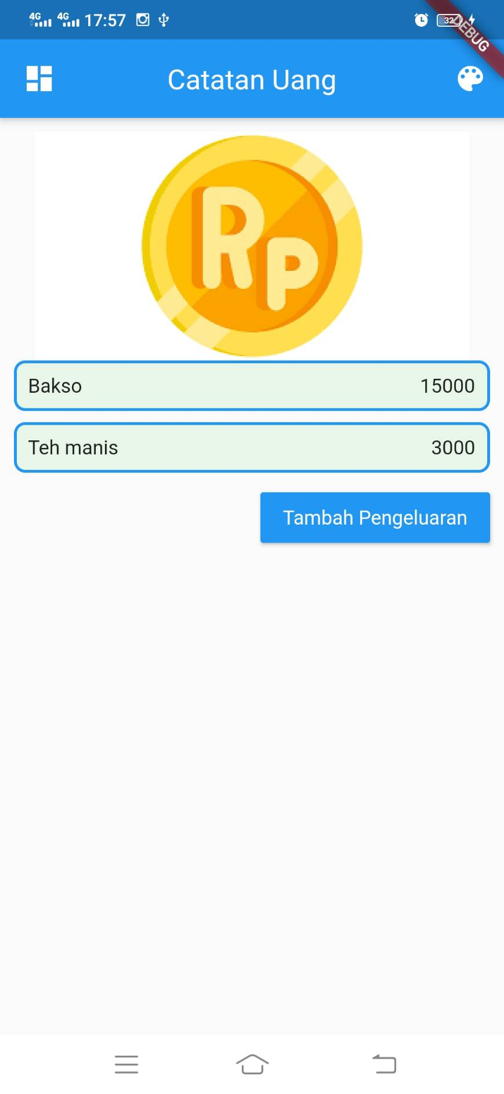
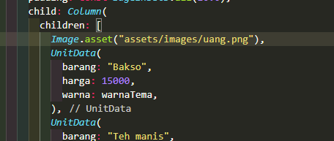
Penggunaan Assets
Untuk penggunaan asset kita dapat menggunakan salah satu method yang terdapat pada kelas image.
Berikut ini adalh syntax pada penggunaan assets.
Image.assets(“alamat_direktori_gambar”)
Notes:
Save Time....:
The Platform will house/aggregate thousands of DIRECT SUPPLIERS. Buyer members are now abled to easily Pick whats best suitable for them.
Discover...:
Suppliers need to be a registered and verified members. There will be features such as ratings and certifications to boost further.
Grow Business:
Members akan di-empowered dengan sebuah tool digital yang yang tadinya menyerang industri, malah justru membuat mereka bisa menjadi lebih kompetitif di era digital.

Slide 8
Icon Aplikasi
Icon aplikasi atau laucher adalah sebuah logo yang akan ditampilkan dalam halaman smartphone.
Berikut ini adalah adalah mengubah icon default flutter menjadi icon yang kita inginkan.
1. Silahkan buat atau cari suatu gambar yang akan dijadikan icon launcher.
2. Silahkan buka link berikut ini :
https://romannurik.github.io/AndroidAssetStudio/icons-launcher.html
Notes:
Save Time....:
The Platform will house/aggregate thousands of DIRECT SUPPLIERS. Buyer members are now abled to easily Pick whats best suitable for them.
Discover...:
Suppliers need to be a registered and verified members. There will be features such as ratings and certifications to boost further.
Grow Business:
Members akan di-empowered dengan sebuah tool digital yang yang tadinya menyerang industri, malah justru membuat mereka bisa menjadi lebih kompetitif di era digital.

Slide 9
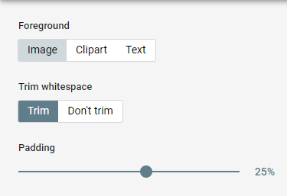
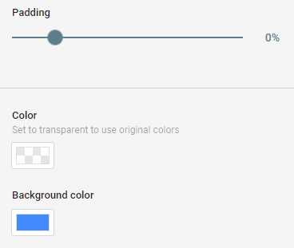
Icon Aplikasi
3. Silahkan klik tombol image pada website tersebut
4. Silahkan upload gambar yang telah anda siapkan, kemudian atur background dan padding sesuai selera anda.
Notes:
Save Time....:
The Platform will house/aggregate thousands of DIRECT SUPPLIERS. Buyer members are now abled to easily Pick whats best suitable for them.
Discover...:
Suppliers need to be a registered and verified members. There will be features such as ratings and certifications to boost further.
Grow Business:
Members akan di-empowered dengan sebuah tool digital yang yang tadinya menyerang industri, malah justru membuat mereka bisa menjadi lebih kompetitif di era digital.

Slide 10

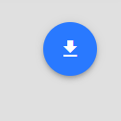
Icon Aplikasi
5. Silahkan buat nama icon. Disarankan tetap gunakan nama default (“ic_launcher”) untuk mempermudah penggunaan di manifest nanti.
7. Kemudian donwload, dengan menklik tombol di sudat kanan atas.
Notes:
Save Time....:
The Platform will house/aggregate thousands of DIRECT SUPPLIERS. Buyer members are now abled to easily Pick whats best suitable for them.
Discover...:
Suppliers need to be a registered and verified members. There will be features such as ratings and certifications to boost further.
Grow Business:
Members akan di-empowered dengan sebuah tool digital yang yang tadinya menyerang industri, malah justru membuat mereka bisa menjadi lebih kompetitif di era digital.

Slide 11
Icon Aplikasi
8. Silahkan ekstrak folder yang telah di download. kemudian buka folder “res” dan copy seluruh isi dari folder “res” ke dalam direktori project sebagai berikut :
android/app/src/main/res
9. Jika anda pemberitahuan replace, silahkan tekan “yes”. Icon default fluter sebelumnya akan digantikan oleh icon yang telah kita buat.
10. silah rebuild ulang aplikasi anda dengan syntax, “flutter clean” dan dilanjutkan dengan “flutter run”
Notes:
Save Time....:
The Platform will house/aggregate thousands of DIRECT SUPPLIERS. Buyer members are now abled to easily Pick whats best suitable for them.
Discover...:
Suppliers need to be a registered and verified members. There will be features such as ratings and certifications to boost further.
Grow Business:
Members akan di-empowered dengan sebuah tool digital yang yang tadinya menyerang industri, malah justru membuat mereka bisa menjadi lebih kompetitif di era digital.

Slide 12

Nama aplikasi
Untuk mengubah nama aplikas anda dapat membuka file AndroidManifest.xml yang terdapat pada direktori android/app/main
Silahkan ubah nama label sesuai kehendak anda.
Notes:
Save Time....:
The Platform will house/aggregate thousands of DIRECT SUPPLIERS. Buyer members are now abled to easily Pick whats best suitable for them.
Discover...:
Suppliers need to be a registered and verified members. There will be features such as ratings and certifications to boost further.
Grow Business:
Members akan di-empowered dengan sebuah tool digital yang yang tadinya menyerang industri, malah justru membuat mereka bisa menjadi lebih kompetitif di era digital.

Slide 13
DISCLAIMER
The information in this presentation is provided to you by PT. AXAR Technology Raya, solely for informational purposes and does not constitute an offer to buy, sell or issue, or a solicitation of an offer to sell, buy or acquire any securities of the Company in any jurisdiction or an inducement to enter into investment activity, nor may it or any part of it form the basis of or be relied on in connection with any contract or commitment whatsoever. No representations or warranties, express or implied, are made by the Company, any underwriters, any of their respective affiliates, directors, officers, employees, advisors or representatives with respect to, and no reliance should be placed, on the accuracy, fairness or completeness of the information presented or contained in this presentation. By viewing this presentation, you agree that none of the Company, any underwriters, nor any of their respective affiliates, directors, officers, employees, advisors or representatives accepts any responsibility or liability whatsoever for any loss howsoever arising from any information presented or contained in or derived from or omitted from this presentation. The information presented or contained in this presentation was obtained from various sources, including certain third parties, and has not been independently verified, and its accuracy is not guaranteed.
This presentation does not contain all relevant information relating to the Company or its securities, particularly with respect to the risks and special considerations involved with an investment in the securities of the Company. These materials are not an offer of securities for sale. Any public offering will be made by means of a prospectus that may be obtained from the issuer and that will contain detailed information about the company and management, as well as financial statements. This presentation speaks as of its date and the information presented or contained in this presentation is subject to change without notice or update.
This presentation contains statements that constitute forward-looking statements. These statements include descriptions regarding the intent, belief or current expectations of the Company or its officers about the future. These statements can be recognized by the use of words such as “expects,” “plans,” “will,” “estimates,” “projects,” “intends,” or words of similar meaning. Such forward-looking statements are not guarantees of future performance and involve risks and uncertainties, and actual results may differ from those in the forward-looking statements as a result of various factors and assumptions, many of which are beyond the Company’s control. The Company or any of its affiliates, advisors, representatives or underwriters has no obligation and does not undertake to revise forward-looking statements to reflect future events or circumstances.
THE INFORMATION CONTAINED IN THIS DOCUMENT IS HIGHLY CONFIDENTIAL AND MAY NOT BE FORWARDED, PUBLISHED OR DISTRIBUTED, DIRECTLY OR INDIRECTLY, TO ANY OTHER PERSON (WHETHER WITHIN OR OUTSIDE YOUR ORGANIZATION/FIRM) FOR ANY PURPOSE AND MAY NOT BE REPRODUCED IN ANY MANNER WHATSOEVER. ANY FORWARDING, PUBLICATION, DISTRIBUTION OR REPRODUCTION OF THIS DOCUMENT IN WHOLE OR IN PART IS UNAUTHORIZED.
THANK YOU

